Slide 1
TAMING TEXAS Judicial Civics and
Court History Project
Teach Texas Classroom Program
LESSON I: The Rule of Law and
The History of Texas Law
Revised 2/2020

Slide 2
The Rule of Law
2

Slide 3
“The rule of law . . . ensures justice between [people], however humble the one and however powerful the other.” —President Dwight Eisenhower
The rule of law is a system of self-government in which everyone, including the government and its officials, is required to follow the law.
Courts help preserve the rule of law by making independent decisions and by applying the law equally to all people.
3

Slide 4
“There can be no free society without law administered through an independent judiciary. If one man can be allowed to determine for himself what is law, every man can. That means first chaos, then tyranny.” —U.S. Supreme Court Justice Felix Frankfurter
Judicial independence means that judges are independent from political pressures and outside influences when they make their decisions.
Everyone who comes before a court should have a fair chance to make their case and to be assured that the judges will be impartial in making their decisions.
4

Slide 5
“The laws people choose for themselves describe the society they live in. Does it protect individual liberty? Respect property rights? Limit government? Treat people equally? Try to provide justice to the rich and poor, the strong and weak, alike? “To us, the answers may seem simple. But over the years, judges and lawmakers have fought against power and prejudice to produce the society we enjoy today.” —Texas Supreme Court Chief Justice Nathan L. Hecht, Foreword to Taming Texas Book 1
5

Slide 6
TAMING TEXAS
The History of Texas Law
6

Slide 7
Early Texas
Spanish and Mexican Roots
7
Notes:
Texas belonged to Spain as a colony in the New World—the students will have studied that period last semester—and the roots of Spanish law remain in Texas law to this very day.
When Mexico won its independence from Spain in 1821, the Texas colony belonged to Mexico, which kept Spain’s laws.

Slide 8
1731-1735 – Spanish Law Arrives in Texas
Canary Islanders arrive in what is now San Antonio, bringing Spanish law with its alcalde system.
Juan Leal Goráz is the first alcalde, serving as a mayor and judge.
8
Notes:
The Canary Islanders were Spanish citizens from off the west coast of Africa. Texas was then a total wilderness, so they were far from civilization. The alcalde was in charge of enforcing Spanish laws, but because they were so far from any other Spanish town, he often make his own rules to fit the needs of the people.

Slide 9
1822-1827 – New Settlers Bring New Laws to Mexican Texas
Stephen F. Austin brings 300 families to Mexican Texas and governs them with regulations based on both English and Spanish legal traditions.
9
Notes:
The new government of Mexico (recently independent from Spain) gave Stephen F. Austin the authority to rule his colony by himself, as long as he didn’t break any Mexican laws. He issued regulations to settle disputes and punish minor crimes; major crimes had to be settled by Mexican authorities in Mexico City.

Slide 10
Texas Becomes Its Own Country
10
Notes:
The Mexican state of Texas becomes the Republic of Texas in 1836.

Slide 11
1836 – Revolution Brings Changes to Texas Laws
The Convention of 1836 meets at Washington-on-the-Brazos in March, then writes the Texas Declaration of Independence and Republic of Texas Constitution.
The 1836 Constitution creates district courts to hear cases and a Texas Supreme Court for appeals.
11
Notes:
You’ve studied about the Texas Revolution that freed Texas from Mexico in April 1836.
The 1836 Republic of Texas Constitution was based both on the United States Constitution and the Mexican Constitution of Coahuila and Texas, so it blended English and Spanish laws that suited the needs of frontier people.
The appellate Supreme Court was new, as were jury trials (Spain and Mexico didn’t have juries, just judges).
As we’ll see, Spanish laws carried over in important ways.

Slide 12
1837 – The Republic’s District Courts Begin Taming the Frontier
The Republic’s four District Judges ride hundreds of miles by horseback to hold court.
Most people welcome the judges, but some threaten them.
Judge Robert M. “Three-Legged Willie” Williamson makes them follow the law.
12
Notes:
Williamson was called “Three-Legged Willie” because he lost the use of one leg as a child and walked with a wooden leg beneath the lame one. That didn’t slow him down, though. He was a great judge who commanded respect. He also was a great dancer.
Many of Judge Williamson’s cases involved criminal hearings. There was a famous story that when Judge “Three-Legged Willie” Williamson set up the first court in the Third District in East Texas behind a crate “bench” under an oak tree (the courthouse had burned down), his first case involved a group of violent feuders. Doubting the ability of a court to give justice, one man thumped his Bowie knife into Williamson’s bench and said, “This, sir, is the law of Shelby County!” Williamson calmly drew his pistol, laid it on the bench next to the knife, and said, “Then this, sir, is the constitution that overrules your law.” The case then proceeded without further disruption.

Slide 13
1839 —Two Presidents Go to Court Sam Houston v. Mirabeau Lamar
13
Notes:
This is a different kind of case—not a criminal case but a civil dispute over property damage. These were very common in those days—pretty much everyone sued someone over something at some point in their lives, so the courts were very busy. As we’ll see, even the Presidents of the Republic sued each other!

Slide 14
The Case: A Dispute Over Broken Furniture
Ex-President Sam Houston sues President Mirabeau Lamar for damage to furniture he loaned Lamar for the new President’s Mansion.
Houston claims Lamar damaged or lost $2,000 worth of furniture after promising to buy it.
Four years later, a jury awards Houston $1,102 in damages. Lamar appeals the decision to a higher court.
14
Notes:
This is a good example of a civil suit that began with failed negotiations between the two parties and proceeded with a jury trial (delayed for four years), which awarded about half the damages asked for.
Houston said Lamar took possession of the furniture in January 1839, and damaged it. Lamar originally admitted that some of the furniture was damaged, but he did not accept responsibility for any missing items. Negotiations between the two broke down, and Lamar asked for a jury trial.
It took four years to work through the problems, including lack of witnesses—one of Lamar’s was killed in a duel, for example, and the others disappeared. Houston had similar problems, but one official who saw the damaged furniture agreed to testify on Houston’s behalf.
The case finally went to trial in April 1843, and a jury awarded Houston $1,101.73 in damages. That’s about $20,000 in today’s dollars.

Slide 15
Did Houston Ever Get His Money?
• The case finally went to the Texas Supreme Court in 1846, and they said the amount the jury awarded three years earlier was fair.
• By then Lamar claimed he didn’t have the money to pay.
• Houston gave up trying and turned over the debt to someone else to collect. Lamar later gave that person $200.
15
Notes:
From the district court, the case went to Texas Supreme Court on appeal, and ended with the Supreme Court affirming the original jury award seven years after the original lawsuit was filed.
This is a good example of how the passage of time can work against one or both parties. Justice delayed is justice denied.
Also, even though the person who was sued was supposed to pay, and the amount was a little over half what was asked for, he said (and could prove on paper) that he had no money. He was a debtor without the means to pay his debt.
Optional exercise:
Can you think of a modern-day situation that would be similar to this case? For example, what if someone borrowed an expensive 10-speed sports bicycle and returned it with punctured tires and a bent frame. If they refused to pay to replace it, what can you do?
[NOTE: You could mention the small claims court and describe how that works. That will be presented in more detail in Lesson 2.]

Slide 16
Texas Becomes a State
16
Notes:
The Republic of Texas decided it would be better off being a state than a country, and it became part of the United States on December 31, 1845. It brought a new constitution with it.

Slide 17
1845 – Texas Law Keeps Parts of Spanish Law
The 1845 Texas State Constitution continues Queen Isabella of Spain’s legal protections for women. A Texas woman:
Keeps property she owned before marriage.
Receives one-half of property acquired during marriage if she is divorced.
Inherits her husband’s property if he dies.
Queen Isabella of Spain, 1479
17
Notes:
When Queen Isabella ruled Spain in the late 1400s, she saw to it that women could own and inherit property, go into business, and be almost equal to men under the law. This was very different from the English-speaking countries, where married women gave up their rights to own property or run a business. Texas preserved the Spanish provisions that gave women these rights. That meant Texas was ahead of the other states, where English law gave husbands control of all property.

Slide 18
1861 – Texas Supreme Court Justices Disagree on Secession (withdrawing from the United States)
Justice Oran Roberts leads the state’s Secessionist movement to join the Confederacy.
Justice James Hall Bell opposes Secession and wants Texas to stay in the United States.
18
Notes:
Texans voted to secede from the United States in 1861, so Unionists like Justice Bell were very unpopular. He was never again elected to office. Justice Roberts, in contrast, was in favor of the Confederacy. He remained popular throughout the Civil War and later became Chief Justice of the Texas Supreme Court and then Governor of Texas.

Slide 19
1864 – Civil War Brings Disorder in the Texas Courts
The Texas Supreme Court loses a battle with Confederate General John Bankhead “Prince John” Magruder over custody of prisoners who were denied protection under Texas law.
This is an early case of military law overruling civilian law in Texas.
19
Notes:
General Magruder arrested a doctor and a lawyer who published a pamphlet that spoke out against the Confederacy, and he suspended the writ of habeas corpus without the legal grounds to do so. If time permits, explain habeas corpus.

Slide 20
1876 – A Constitution with Staying Power
In February 1876, Texas adopts a new Constitution still in effect today.
The new Constitution requires all judges to be elected by the people.
20
Notes:
This Texas Constitution deliberately limited the powers of the state government and its officials—especially those of the Governor—because the delegates who wrote it wanted to keep more power in the hands of the people.
During the Civil War, judges had been appointed by a military government and then by the governor, but since 1876 they have been elected by popular vote.

Slide 21
A New Era: Railroads, Big Business, and Changing Laws
21
Notes:
By the 1880s, “big businesses” from other states—including railroads—had gained power over the Texas economy. This had some good effects, but it also had many bad ones that needed new laws to handle. The next slides will give examples.

Slide 22
1880s – Texas Courts Hold the Big Guys Accountable
New laws and court rulings help protect Texans from abuses by big national businesses, especially railroad companies.
22
Notes:
[Go immediately to the railroad case that follows.]

Slide 23
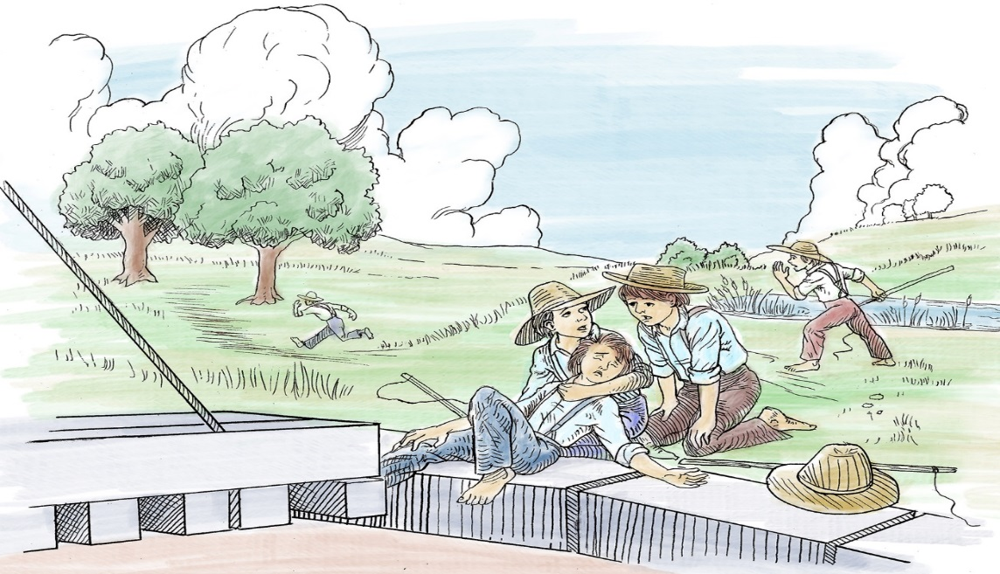
Guess Who Won This Case…
Houston and Texas Central Railway v. Simpson (1883)
23

Slide 24
The Case…
S. P. Simpson, age 10, often plays in a field next to a railroad yard with a “turntable” that turns train engines around and sends them in different directions.
One day while Simpson is playing on the turntable, it moves and crushes his leg.
His family sues for damages, but the railroad says that Simpson, not the railroad, is at fault because he was trespassing. Who Won? Why?
24
Notes:
Have a student read the text and let students guess the decision before moving to the next slide.

Slide 25
The Decision…
• The Texas Supreme Court said the railroad should have known that the turntable would attract children and should have taken steps to protect them from harm. The turntable was an “attractive nuisance.”
• The railroad had to pay the Simpsons $3,500 in damages, a large amount of money in 1883.
25
Notes:
This was the first case in which the Texas Supreme Court applied the new attractive nuisance doctrine that the U.S. Supreme Court had recently established. It was one of the first tort cases in Texas.
Students can be made aware that damages for personal injuries—even very severe ones—were not part of Texas law until many years after the courts were established.

Slide 26
Important Steps Forward: Women’s Rights and Civil Rights
26
Notes:
Legal rights for women and non-Anglo Texans came into focus in the twentieth century.

Slide 27
A Special Case: Johnson v. Darr —1925
• The Woodmen of the World (WOW) claimed ownership of two tracts of land in El Paso.
• A man named Johnson claimed the land was his for payment of a WOW member’s debts.
• The case made history because the Supreme Court that heard it was made up of women!
27
Notes:
We’ll see why the Court was made up just of women in the next slide…

Slide 28
The First All-Woman Supreme Court in the United States
Governor Pat Neff appointed three women lawyers to serve on the Texas Supreme Court to hear the WOW case.
The regular Justices, all men, were disqualified because they had what is called a “conflict of interest.”
They all belonged to the WOW fraternal (men only) organization.
28
Notes:
Johnson and the WOW won the case and kept both tracts of land.
What makes this case interesting is that all three members of the Texas Supreme Court belonged to the WOW fraternity. The question is whether they could judge this case fairly.
Although some historians have said that Governor Neff appointed all women because no male lawyers were available who did not belong to the Woodmen of the World, newer evidence shows that to be untrue. There were indeed qualified male candidates, but Neff was a strong supporter of women’s rights and intended to make a statement with the appointments.
To put this 1925 Court appointment in perspective, women had only been able to vote for 6 years, and they were not permitted to serve on juries for almost 30 more years—in 1954.
The number of female lawyers was also very limited—the first women were licensed in the early 1900s. The next woman to serve on the Texas Supreme Court would be appointed in 1982.

Slide 29
1950 – An Early Civil Rights Victory in the Courts
A landmark U.S. Supreme Court case from Texas, Sweatt v. Painter, opens the University of Texas Law School to African Americans.
After that, “separate but unequal” schools were challenged more and more.
Heman Sweatt waits in line to register for courses at UT Law.
29
Notes:
The law school created for African Americans was declared by the U.S. Supreme Court to be separate and unequal, which it was. The law required that separate institutions based on race had to be equal to those for whites. This was the first step toward the 1954 Brown v. Board of Education ruling, and it began here in Texas.

Slide 30
1954 – A Civil Rights Victory for Mexican Americans
The landmark Hernandez v. State of Texas case gives Mexican Americans important rights under the U.S. Constitution’s 14th Amendment.
The ruling means they can’t be barred from schools or juries because they are Hispanic.
Texas attorney Gus Garcia argues his case to the U.S. Supreme Court
30
Notes:
This marked the first time that the U.S. Supreme Court recognized Mexican Americans as a separate group entitled to legal protection from discrimination. This meant that they could no longer be barred from serving on juries or going to the same public schools as Anglo students because of their cultural background.

Slide 31
Law and Order Today
31

Slide 32
Some Facts about the Texas Supreme Court
• The Court meets in Austin, Texas.
• It is made up of a Chief Justice and 8 Justices.
• All 9 members of the Court are elected.
32

Slide 33
The Texas Supreme Court in 2020
33
Notes:
The first photo shows the nine current members of the Supreme Court, with Chief Justice Nathan Hecht seated at center in the front row.
The next lesson will show how the Texas court system works. You might be surprised by how many courts there are today and what kinds of cases they’re responsible for.

Slide 34
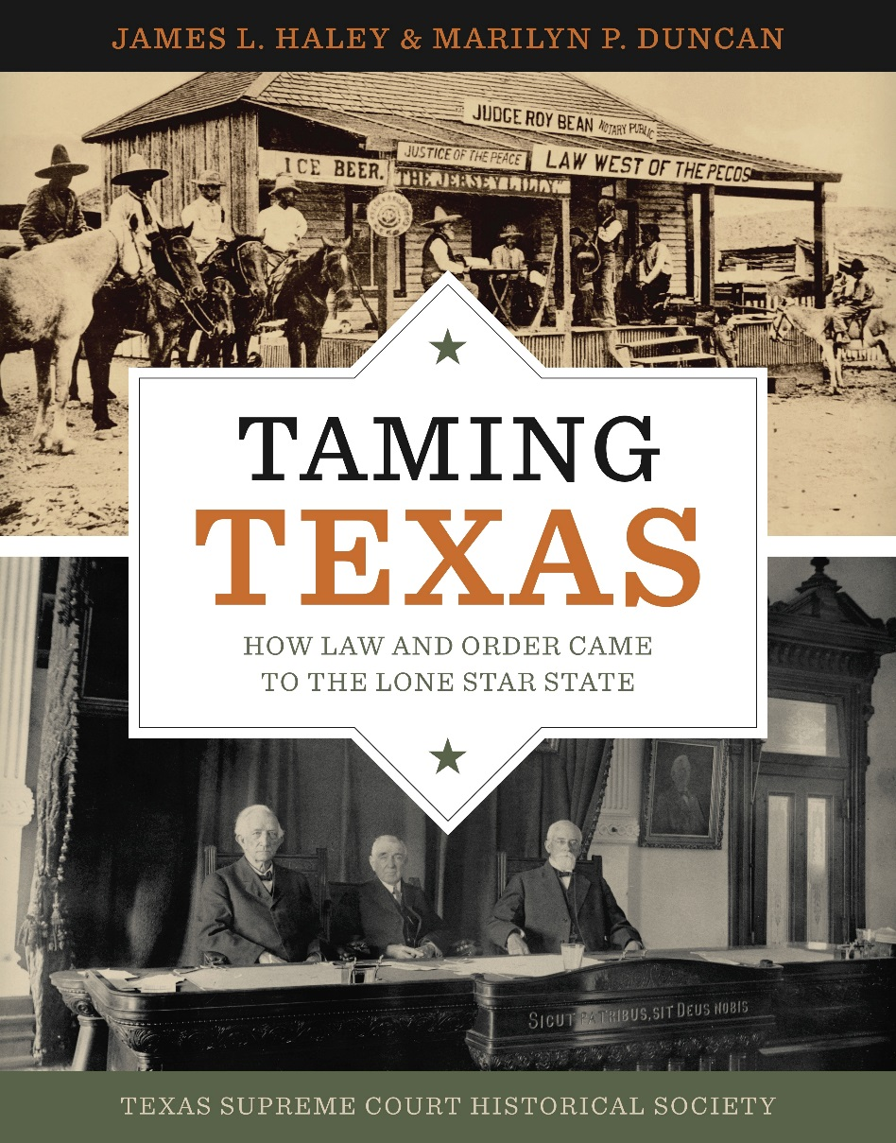
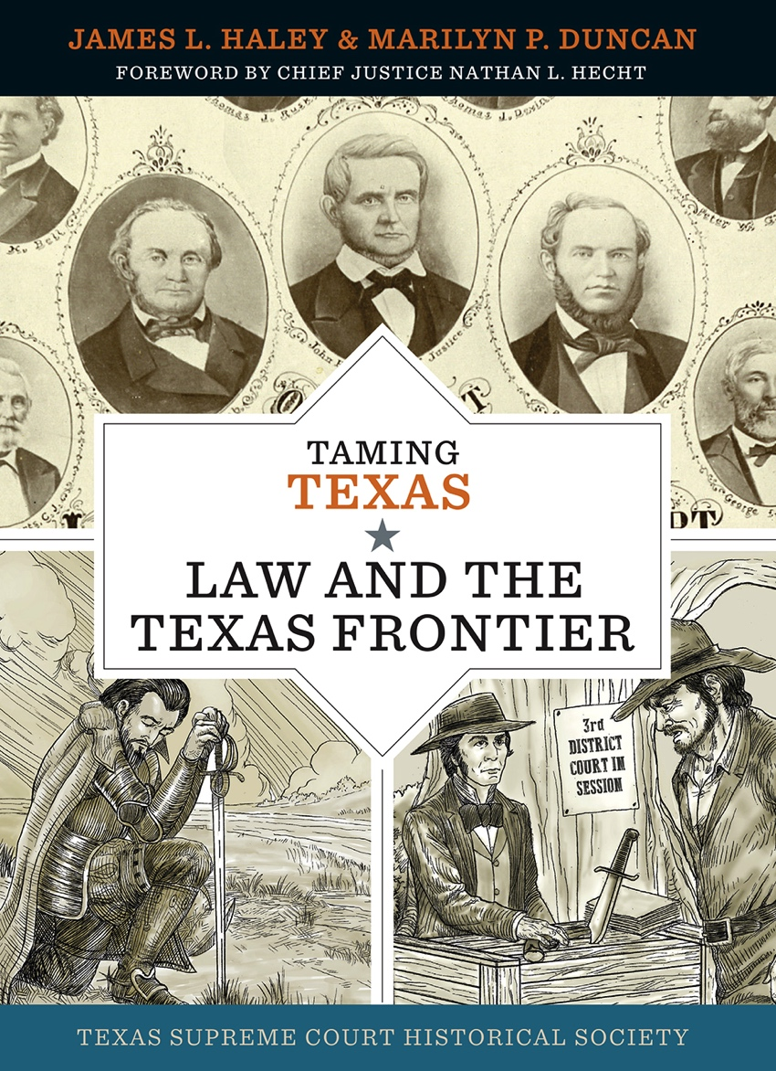
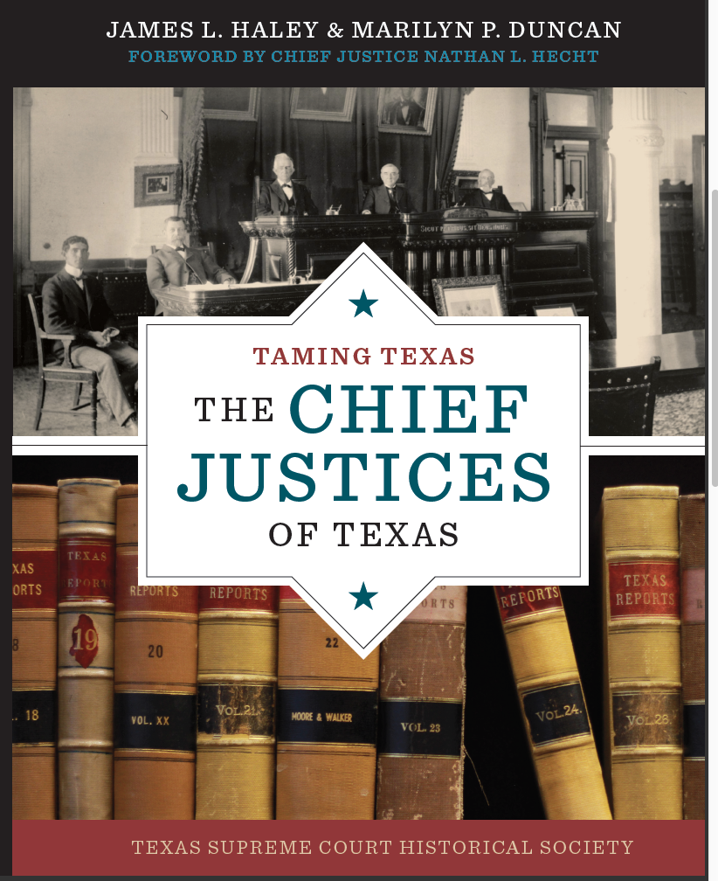
TAMING TEXAS Books
Notes:
Your teacher has a copy of each of the Taming Texas books. You can find out much more about Texas courts and law in the books.

